Slide 1
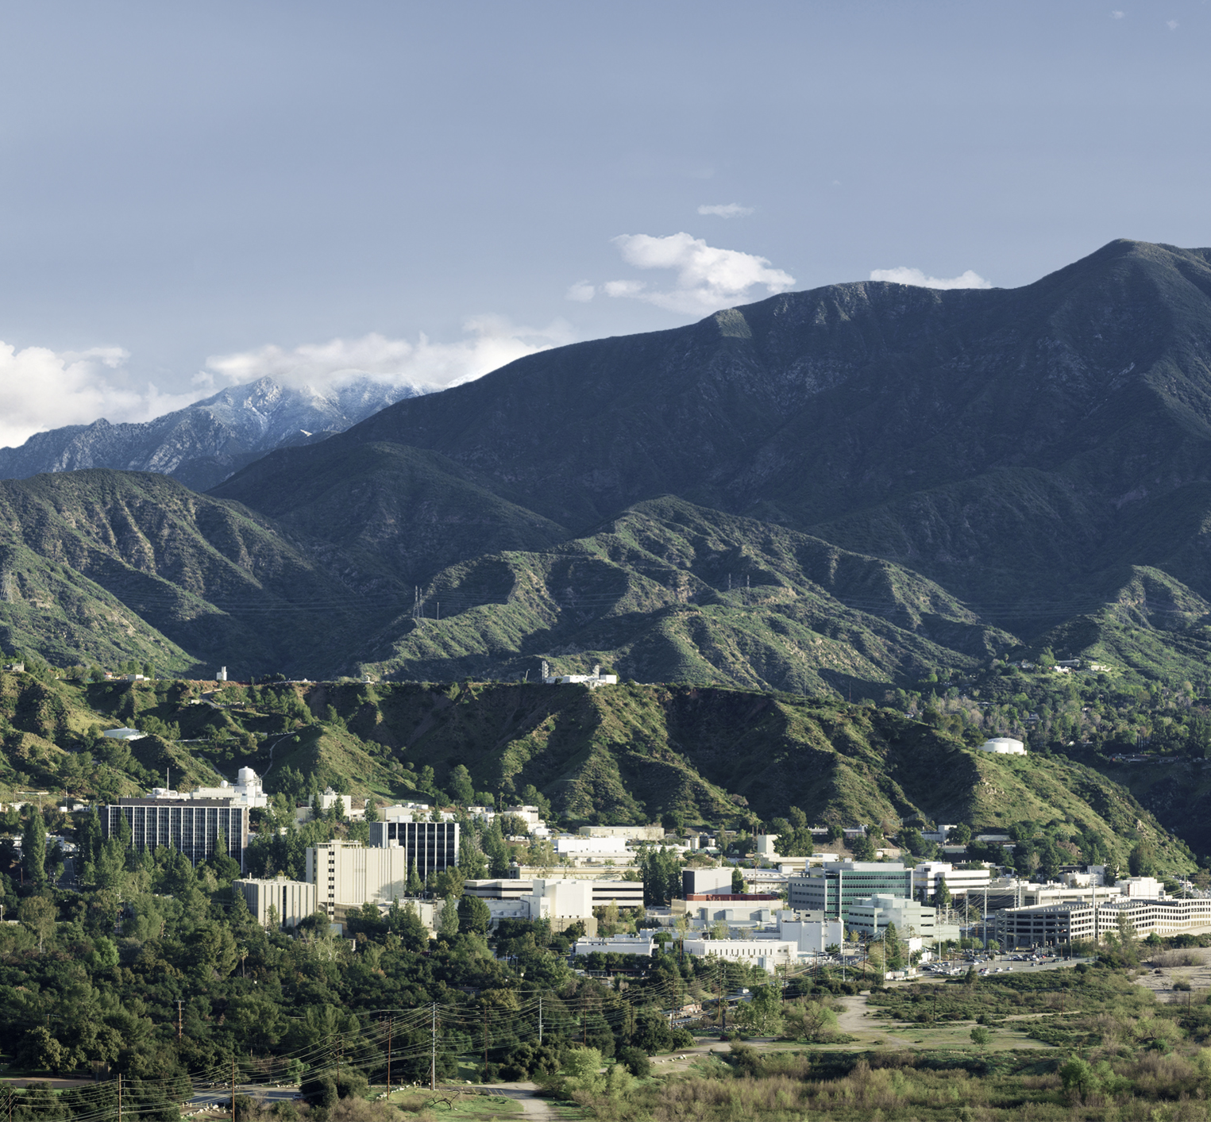
PolSARproSim+
PolSARproSim+ Tree Models
Richard A. Herrera, Razi Ahmed
Jet Propulsion Laboratory, California Institute of Technology

Slide 2
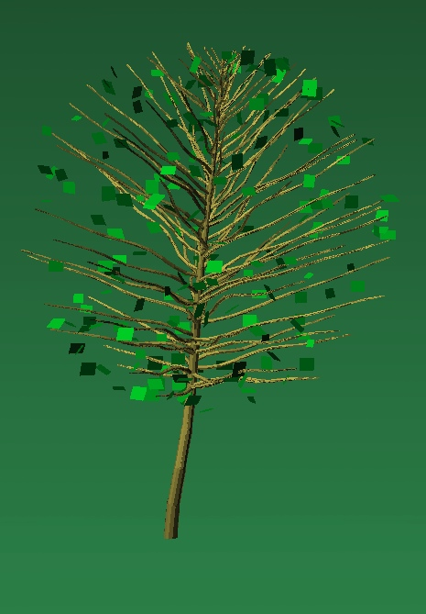
Default Deciduous Tree

Slide 3
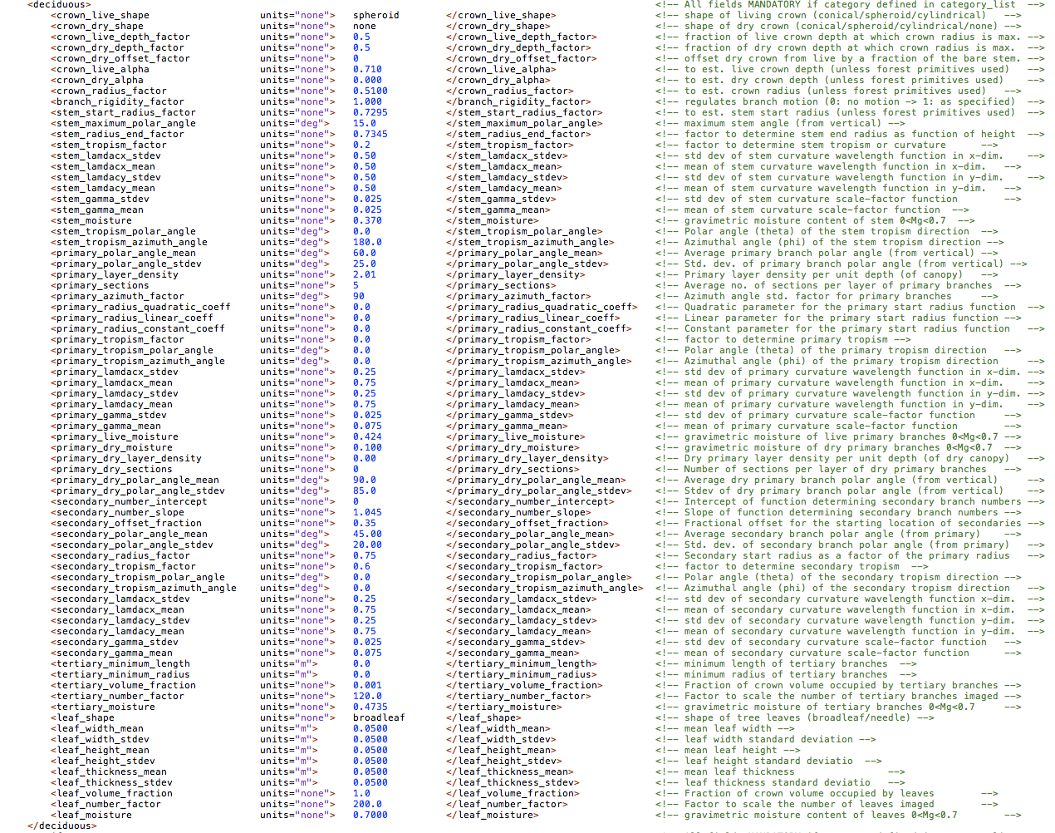
Default Deciduous Parameters

Slide 4
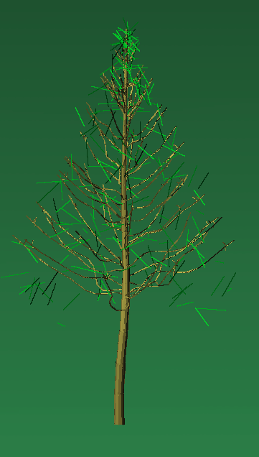
Default Coniferous Tree

Slide 5
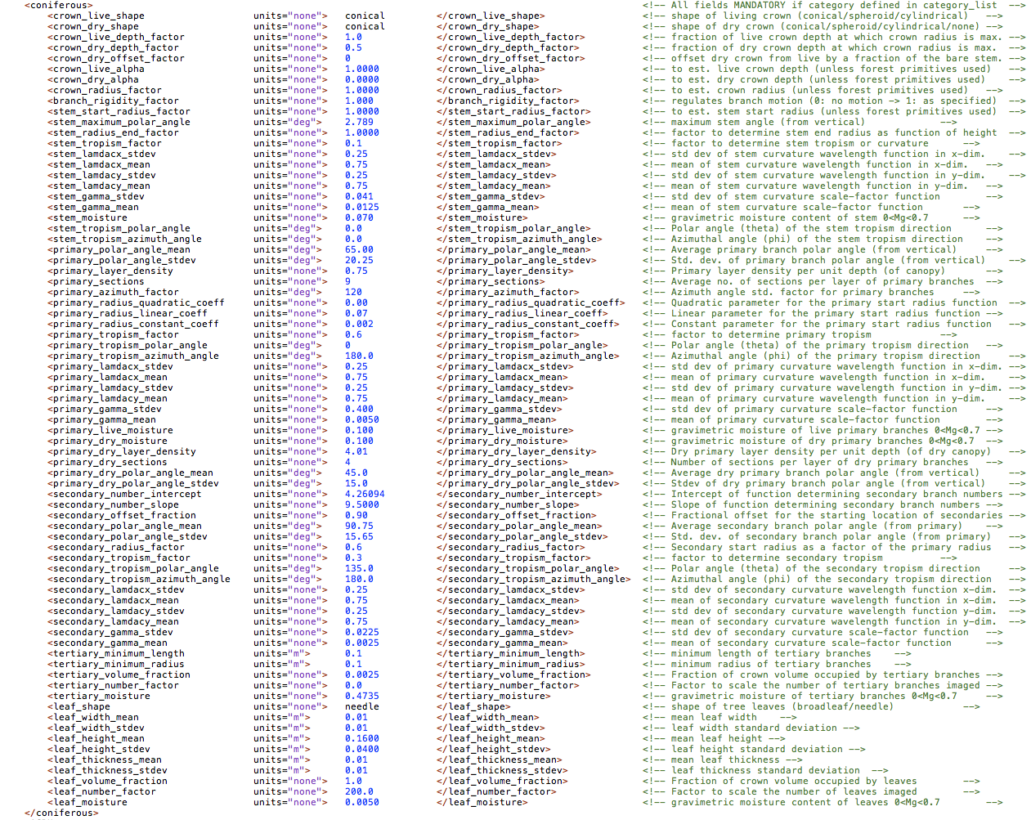
Default Coniferous Parameters

Slide 6
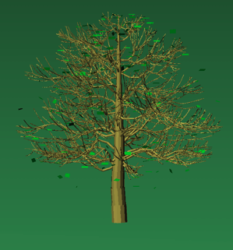
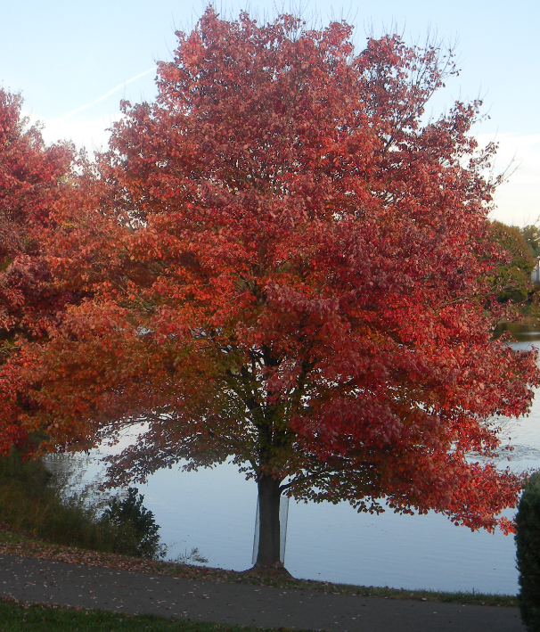
Acer rubrum
Red Maple

Slide 7
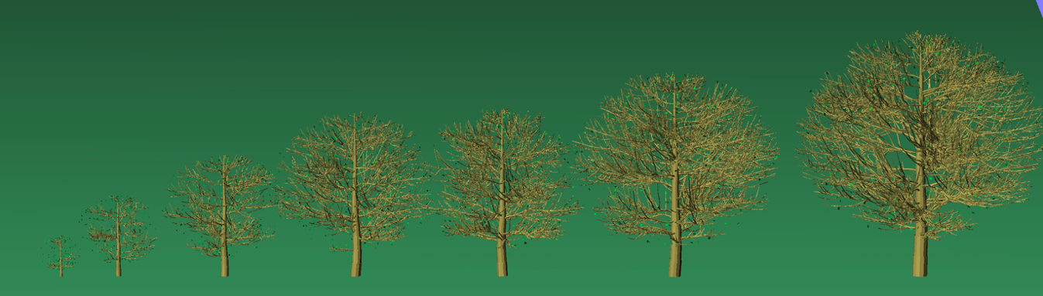
Various Heights

Slide 8
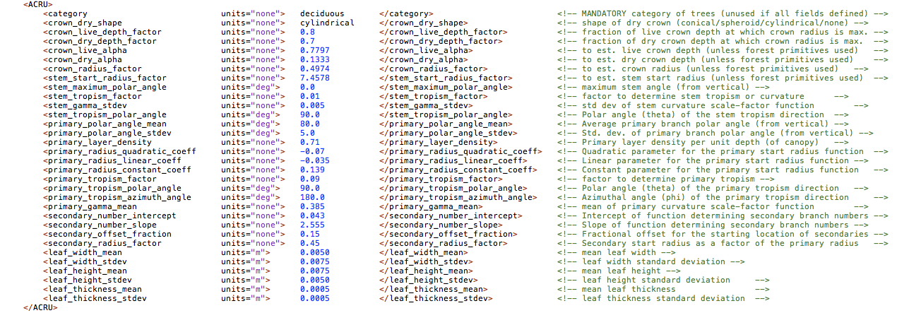
Changes to Default

Slide 9
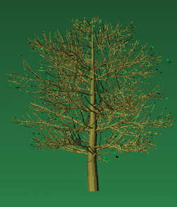
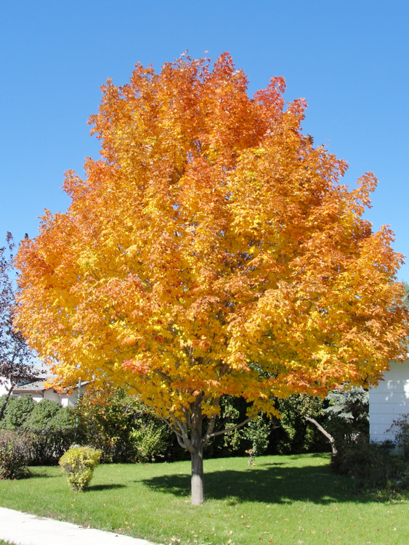
Acer saccarum
Sugar Maple

Slide 10
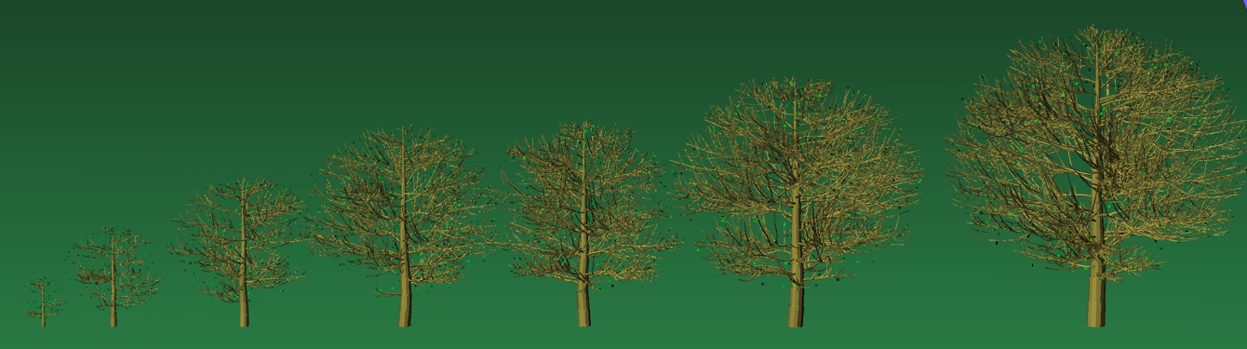
Various Heights

Slide 11
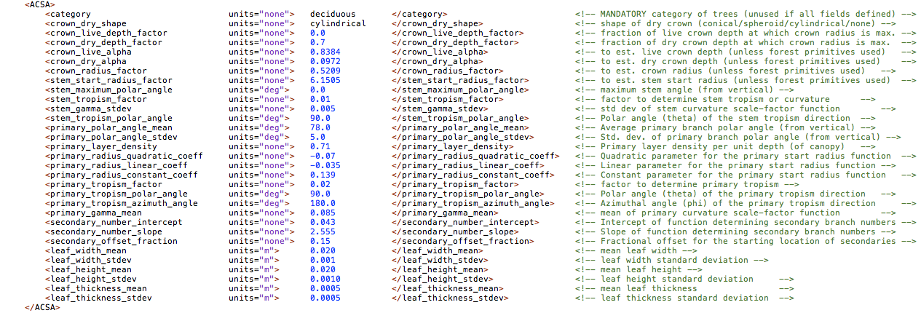
Changes to Default

Slide 12
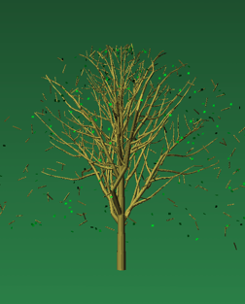
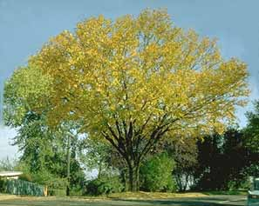
Betula alleghensis
Yellow Birch

Slide 13
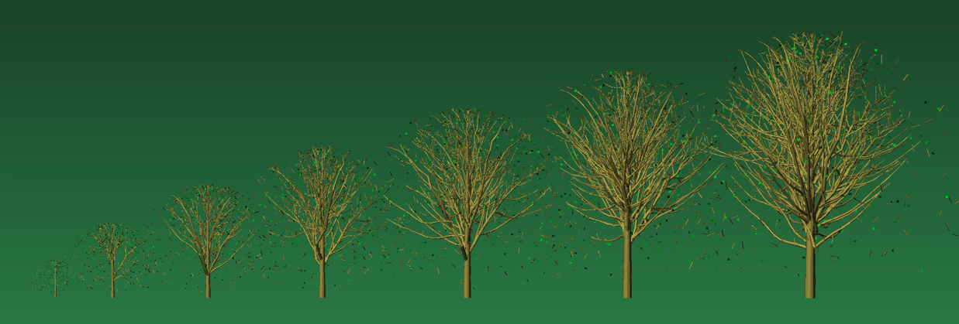
Various Heights

Slide 14
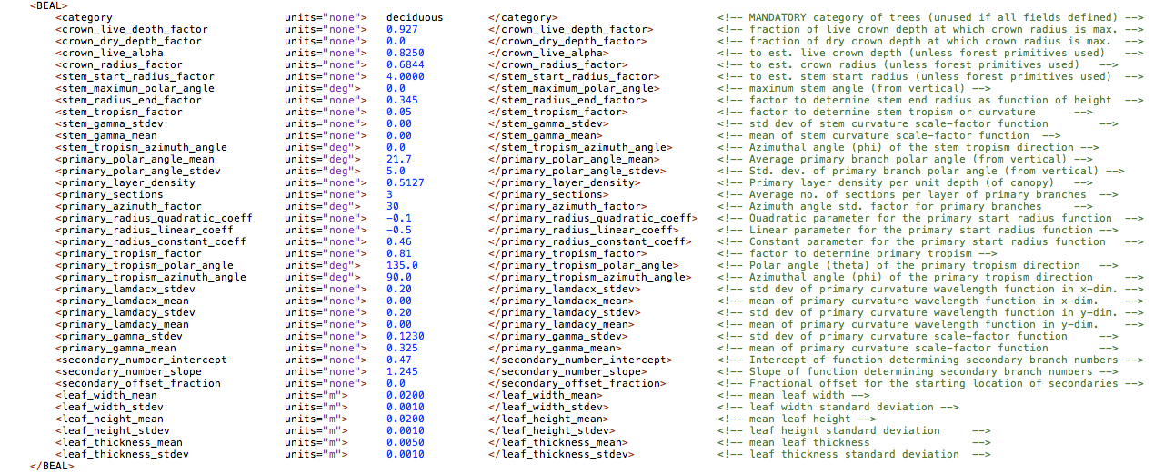
Changes to Default

Slide 15
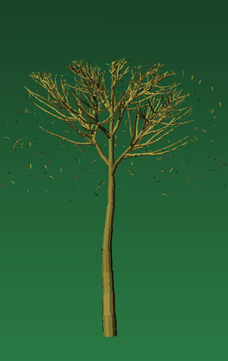
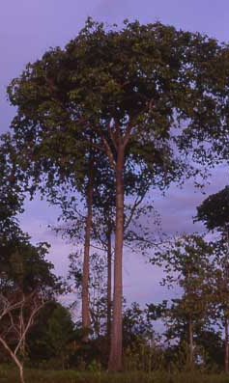
Bertholletia excelsa
Brazil Nut

Slide 16
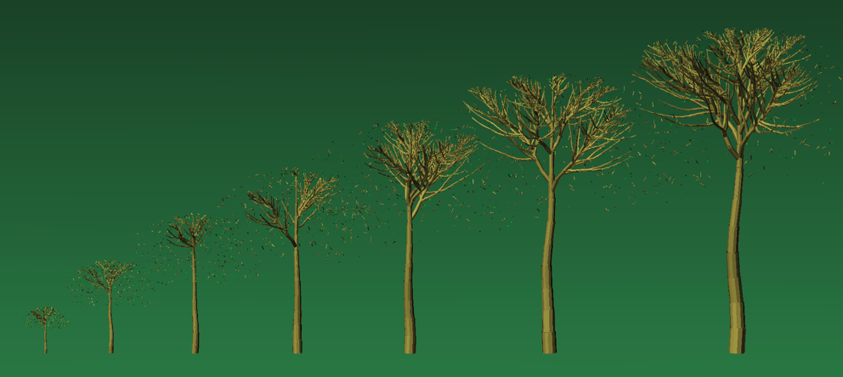
Various Heights

Slide 17
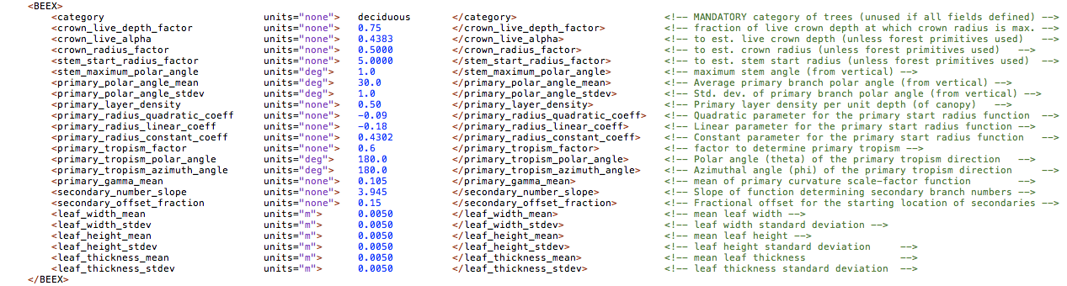
Changes to Default

Slide 18
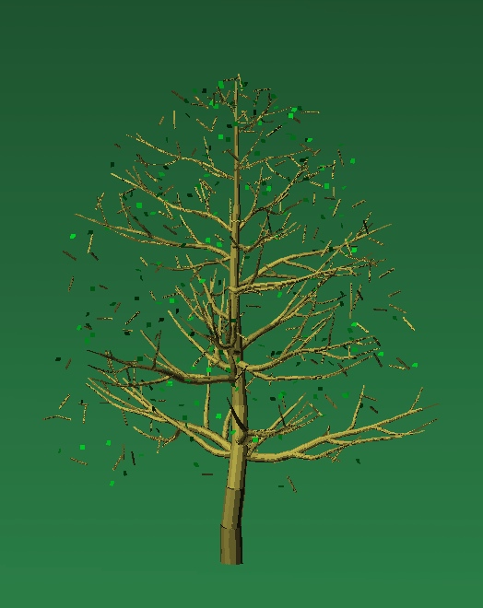
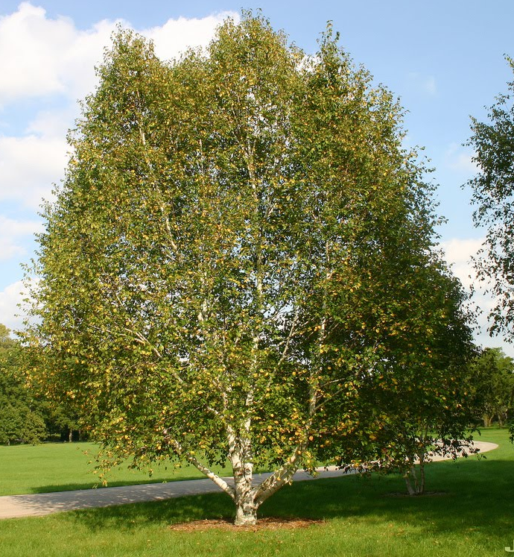
Betula papyrifera
Paper Birch

Slide 19
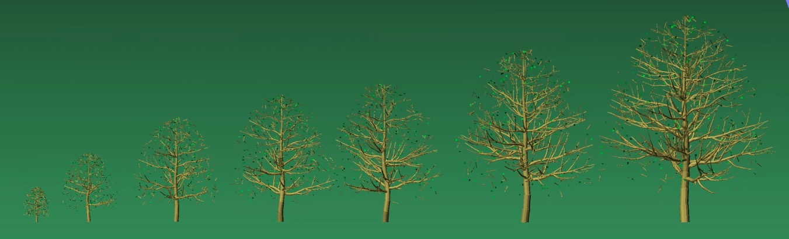
Various Heights

Slide 20
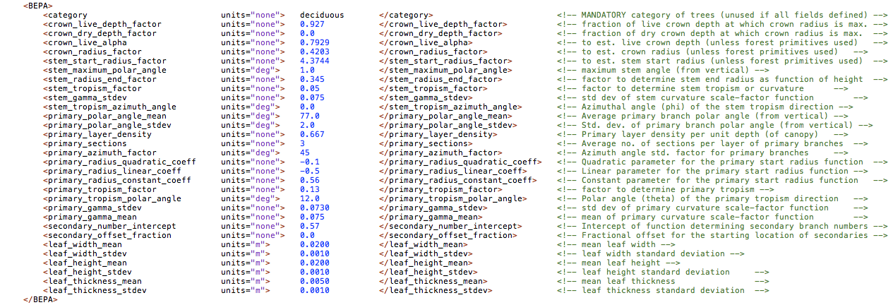
Changes to Default

Slide 21
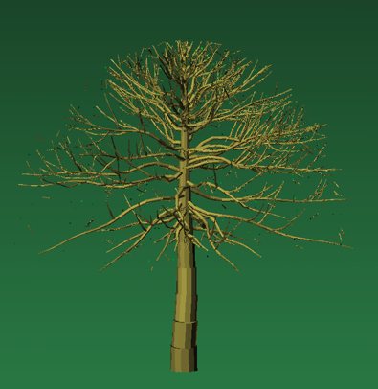
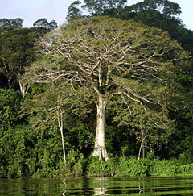
Ceiba pentandra
Kapok

Slide 22
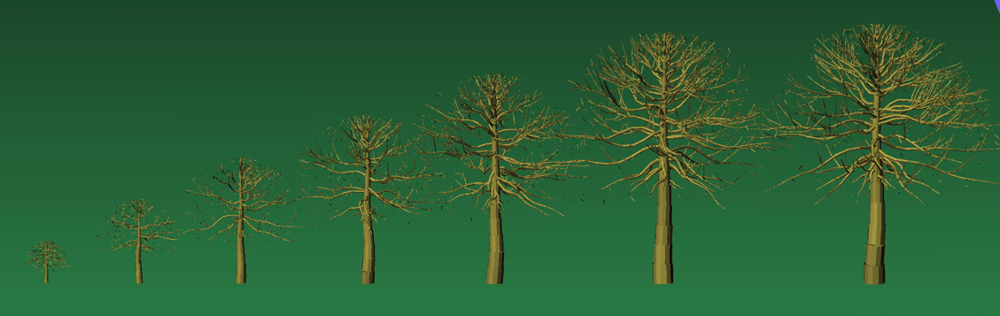
Various Heights

Slide 23
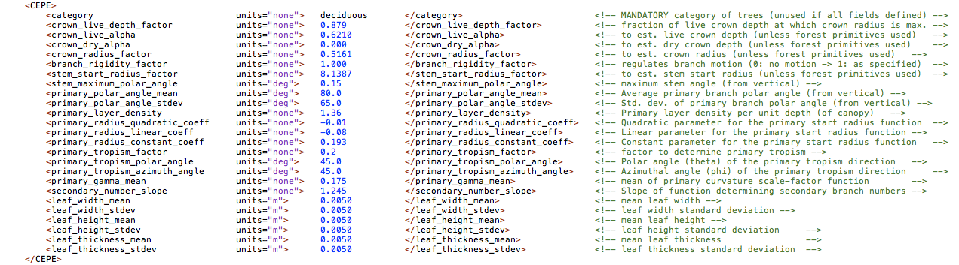
Changes to Default

Slide 24
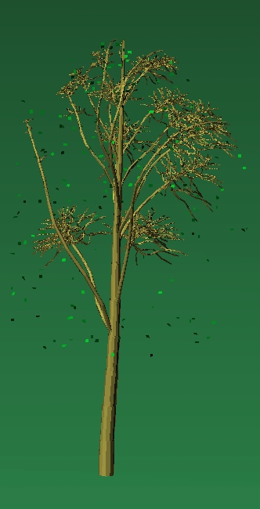
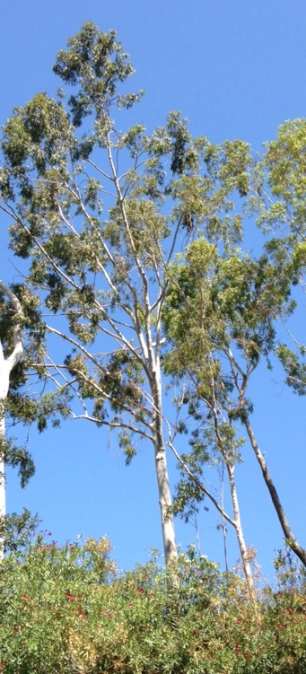
Eucalyptus platypus
Eucalyptus

Slide 25
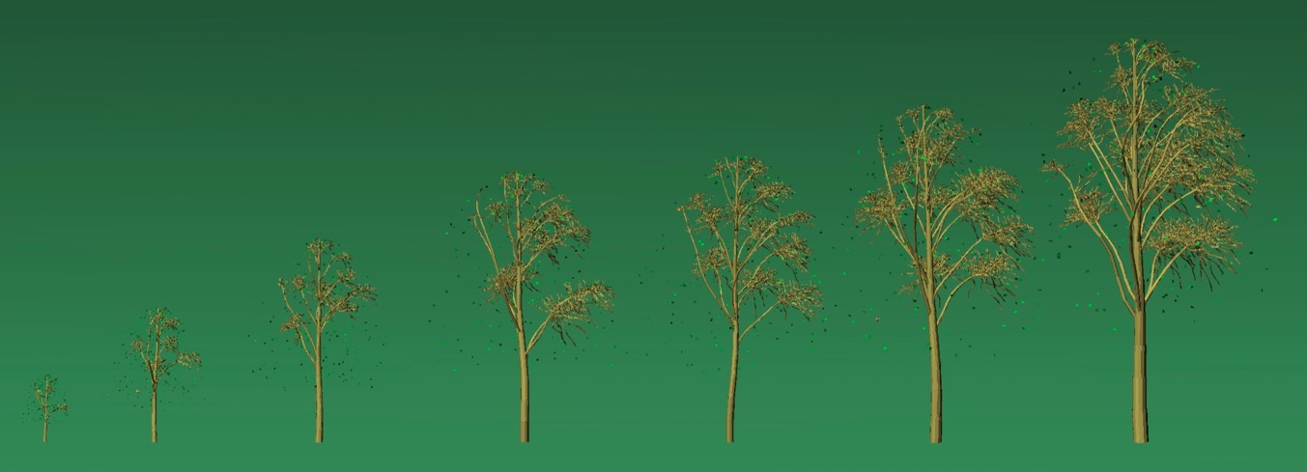
Various Heights

Slide 26
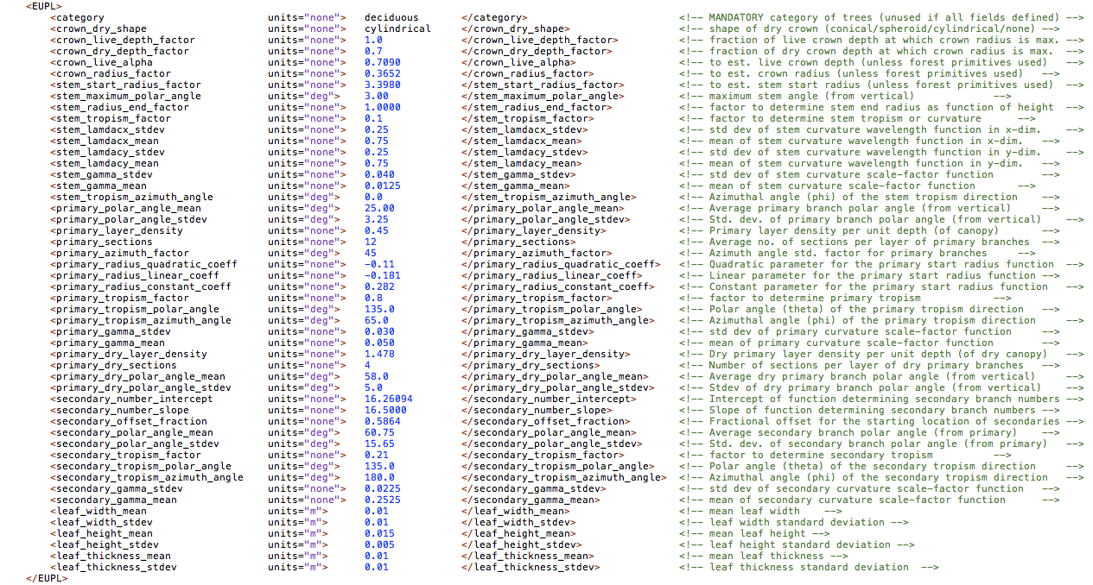
Changes to Default

Slide 27
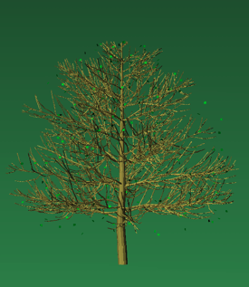
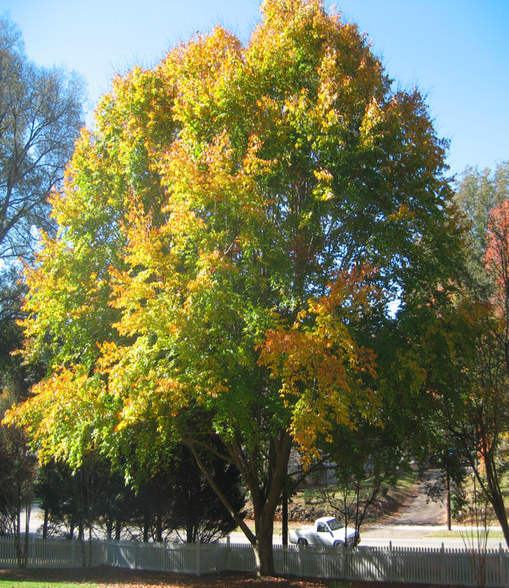
Fagus grandifolia
American Beech

Slide 28
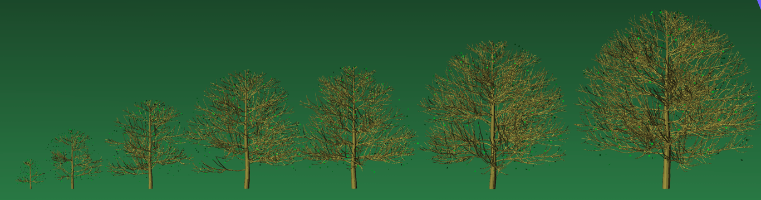
Various Heights

Slide 29
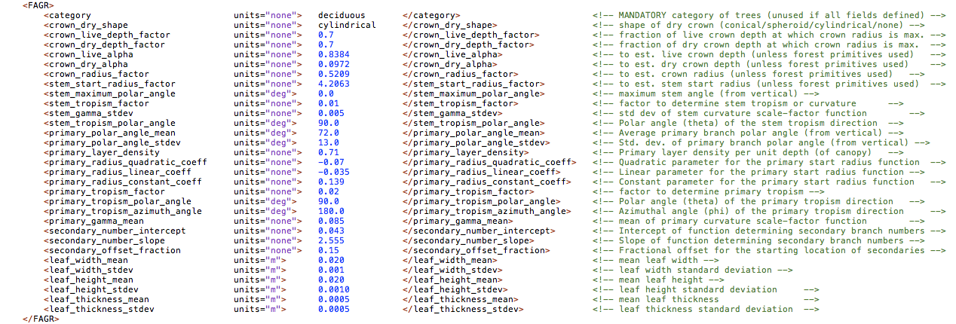
Changes to Default

Slide 30
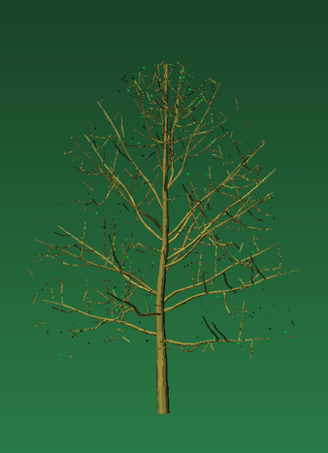
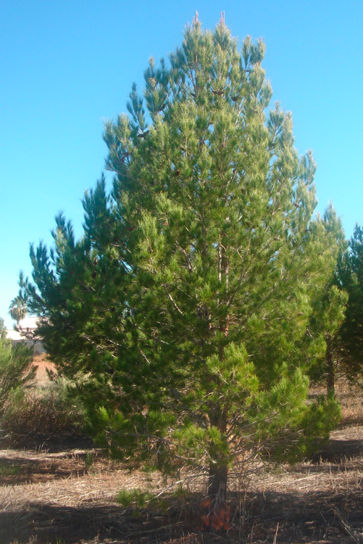
Ostrya virginiana
Hophornbeam

Slide 31
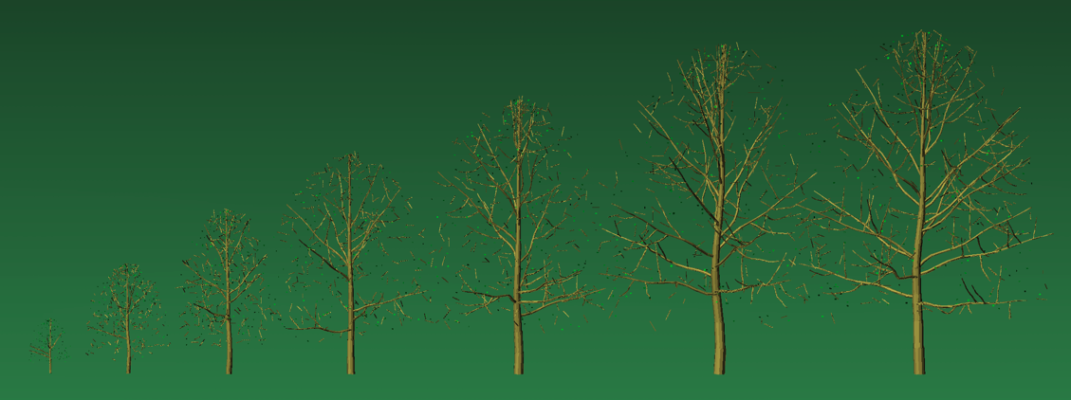
Various Heights

Slide 32
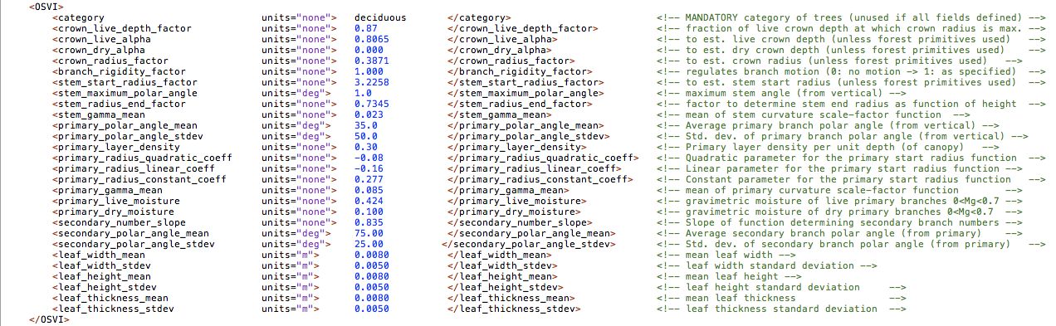
Changes to Default

Slide 33
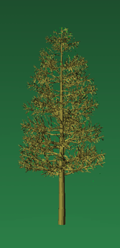
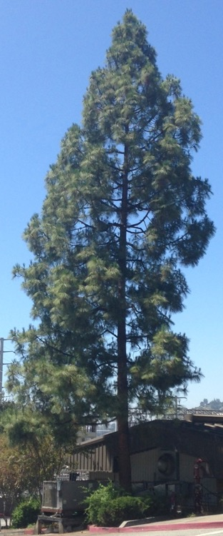
Pinus resinosa
Red Pine

Slide 34
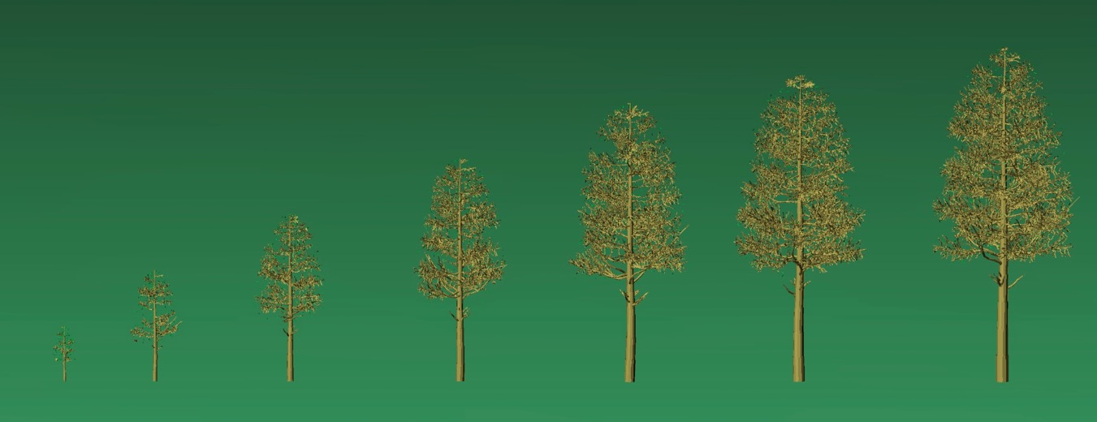
Various Heights

Slide 35
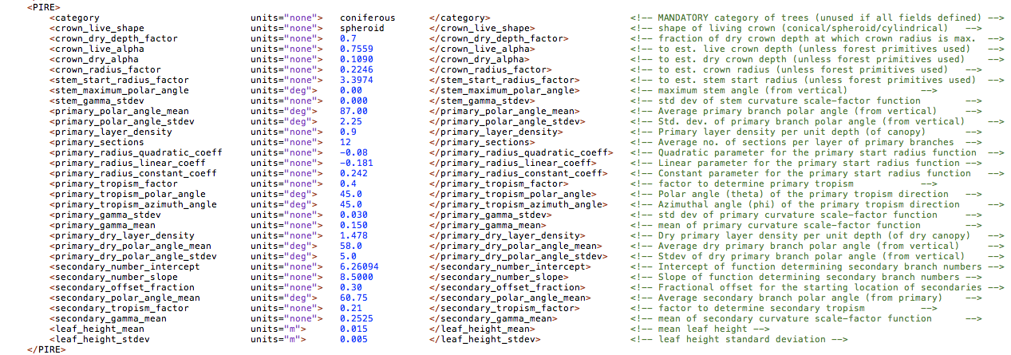
Changes to Default

Slide 36
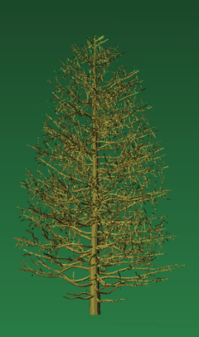
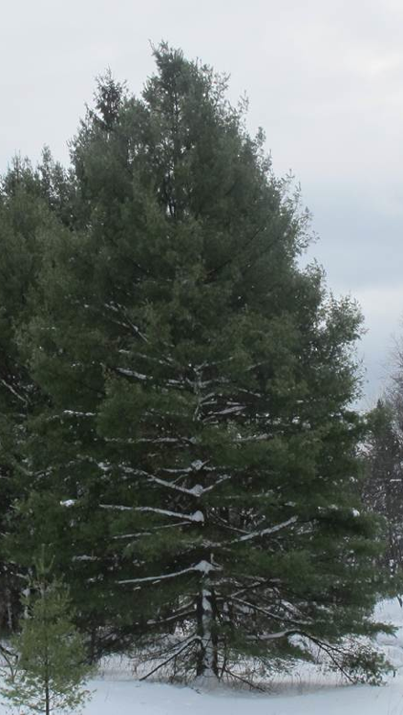
Picea rubens
Red Spruce

Slide 37
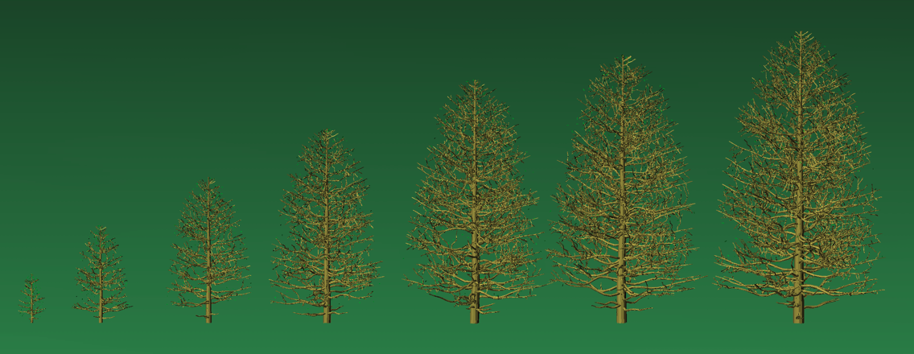
Various Heights

Slide 38
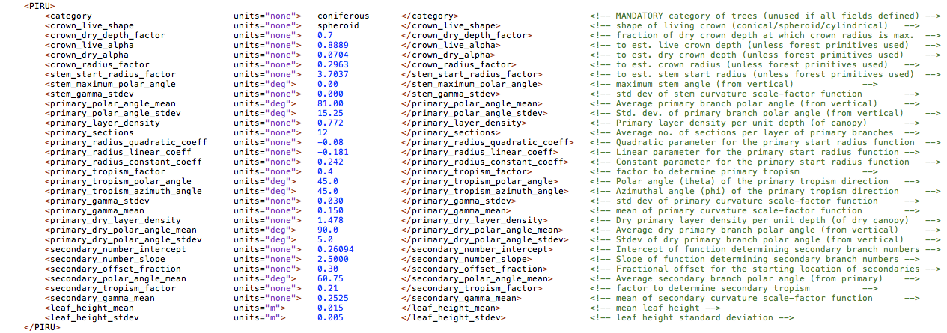
Changes to Default

Slide 39
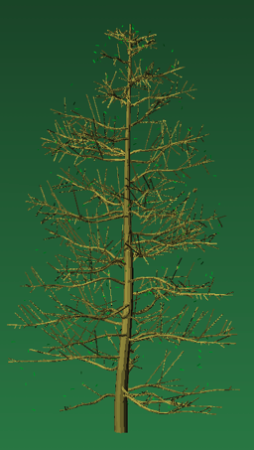

Pinus strobus
White Pine

Slide 40

Various Heights

Slide 41

Changes to Default

Slide 42


Prunus serotina
Black Cherry

Slide 43

Various Heights

Slide 44

Changes to Default

Slide 45


Quercus alba
White Oak

Slide 46

Various Heights

Slide 47

Changes to Default

Slide 48


Quercus rubra
Red Oak

Slide 49

Various Heights

Slide 50

Changes to Default

Slide 51


Rhizophora mangle
Red Mangrove

Slide 52

Various Heights

Slide 53

Changes to Default

Slide 54


Tsuga canadensis
Eastern Hemlock

Slide 55

Various Heights

Slide 56

Changes to Default

Slide 57


Washingtonia filifera
Palm

Slide 58

Various Heights

Slide 59

Changes to Default

